Slide 1


Junwoo Jang
Matthew Silva
Monica Romero
Younghoo Cho

Slide 2
What is RaiderMeet?
For people who need friends for any situations, but only for Texas Tech Students
Not many opportunities to make friends & Not easy to talk first to strangers in real life.
Random questions function for some people

Slide 3
Compared to existing dating apps
Not just for relationships, but for any situation
No more swipe, No more judge appearance only
Don’t need matches! You can talk to anyone first
Safety first with student verification System: No more just random, weird strangers!

Slide 4
Functions and usage
Updating profile/profile picture
Add personal information including major, classification, age, gender, hobbies, etc.
Choose who you attract based on your profile
Direct messaging friends
General communication between friends to plan activities together
Must be friends with each other to utilize messaging
Find friends
Look up other people with similar interests
Different categories to narrow search options

Slide 5
Benefits and advantages
Meeting new people with similar majors/interests
Can also receive help from others with higher classification
Meet people nearby
Narrow search options
Respective categories to reduce search time
More efficient than searching through each individual profile for a match
Safer/more comfort than apps such as Meetup, Bumble, etc.
Strictly Texas Tech students (verified by TTU login)
Allows students to feel more comfortable knowing they’re interacting with other students
Free to users

Slide 6
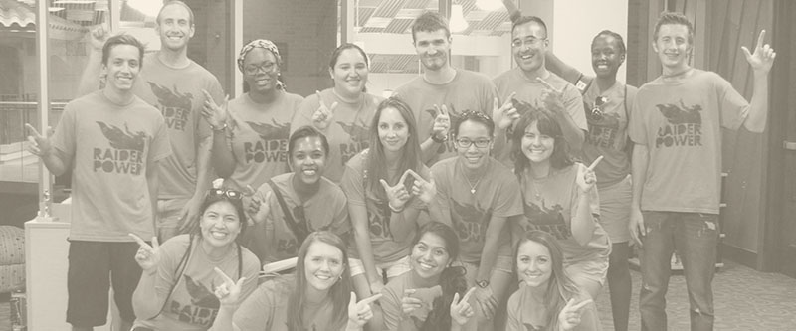
Requirements
Allows Tech students to find new friends on campus
Direct Message
Profile
Costs
Free
Effort
Commitments

Slide 7

Resources
Computer/ Laptop
User: Android Device
Phone
Tablet
Android Studio IDE
Windows
Mac
Linux
Java

Slide 8
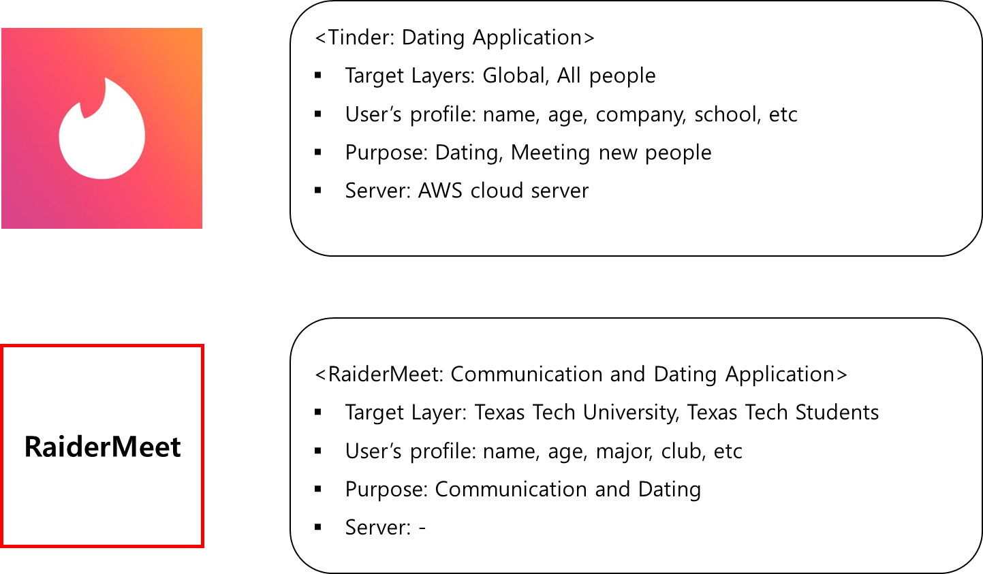
Notes:
2-1, Cho

Slide 9
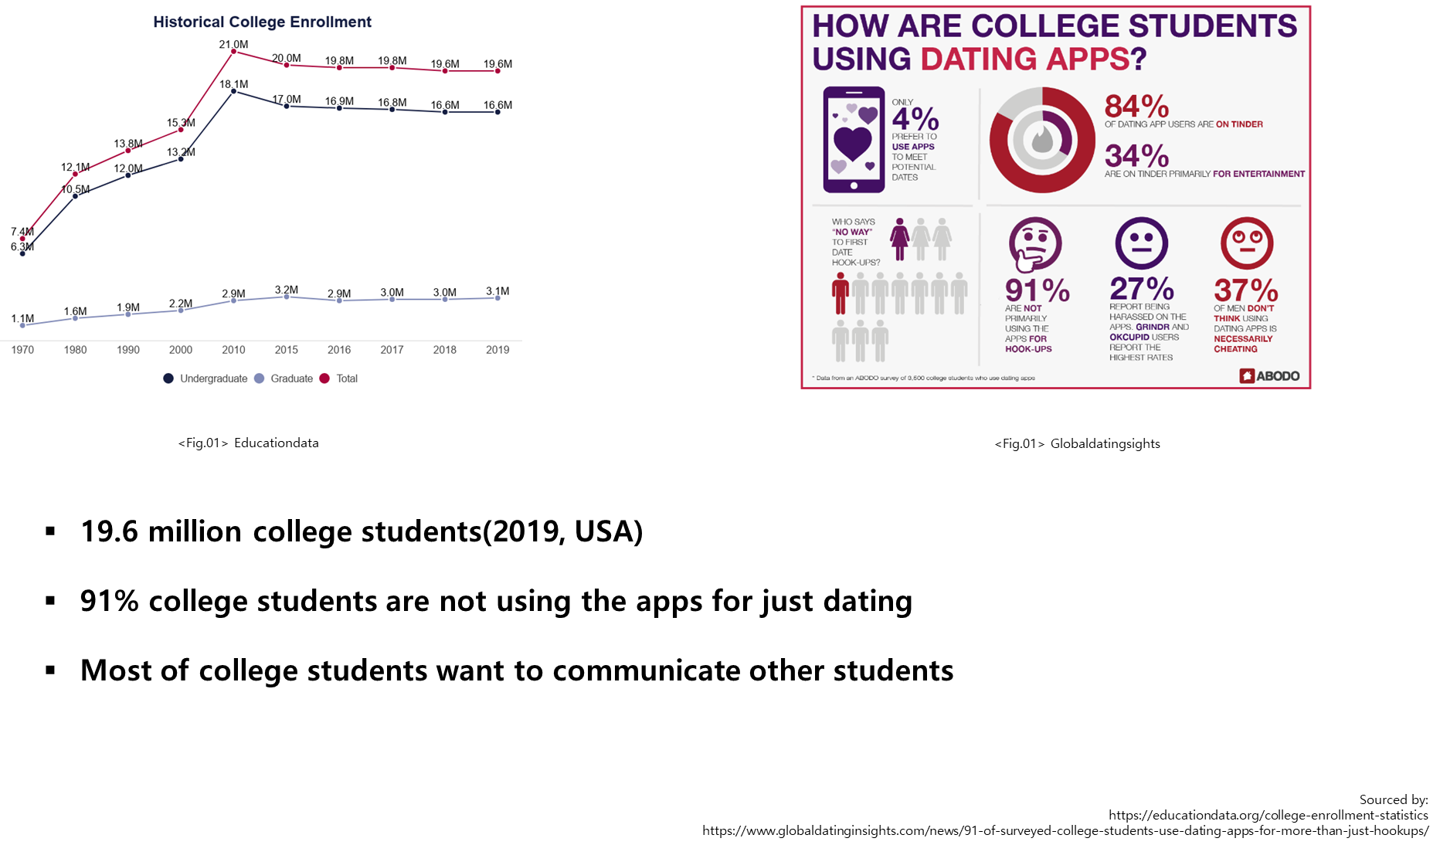
Notes:
2-2, Cho

Slide 10
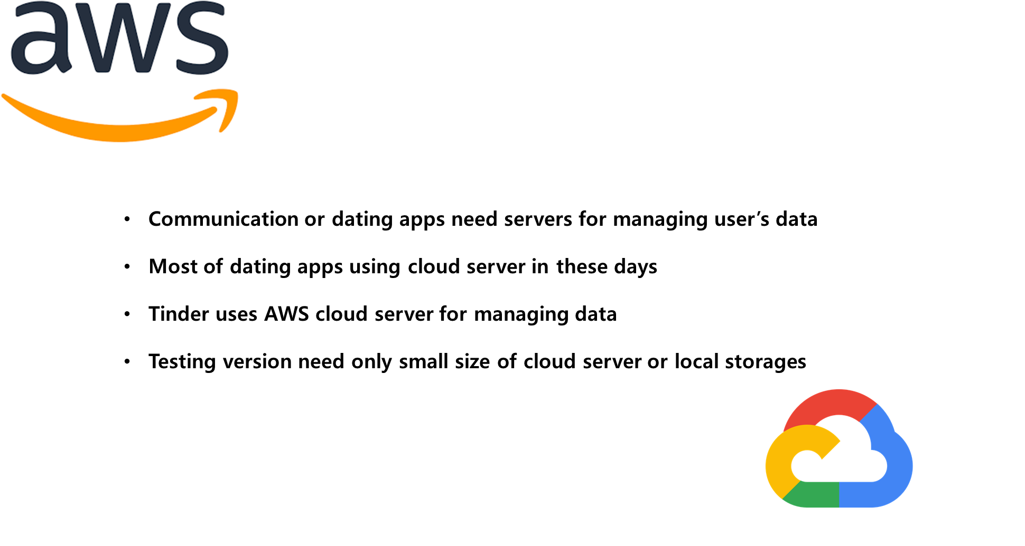
Notes:
3, Cho

Slide 11
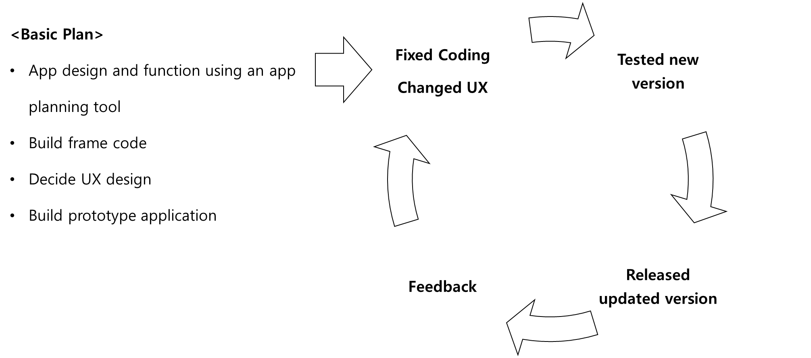

Notes:
8, Cho

Slide 12
Thank you!

